Slide 1

E-health care based on tata health
COURSE CODE:CSA371
COURSE NAME:SOFTWARETESTING
DATE :31.01.2023
NAME:ARJUN.B
REG: 192011021

Slide 2
objectives
To promote healthy living and to facilitate prevention, early detection and management of non-communicable diseases

Slide 3
Abstract
Healthcare is among the fastest-growing sectors in both developed and emerging economies.The project helps to get the accurate functionalities of the web application.
As this e-website has huge impact on current world , it is important to test the websites and applications.

Slide 4
Proposal system
Installing android studio and appium application
Setting up an emulator in android studio with latest version
Getting C code for chrome application in android studio
Tata 1mg
User ID
Location
Search medicines
Health care support
Health product

Slide 5
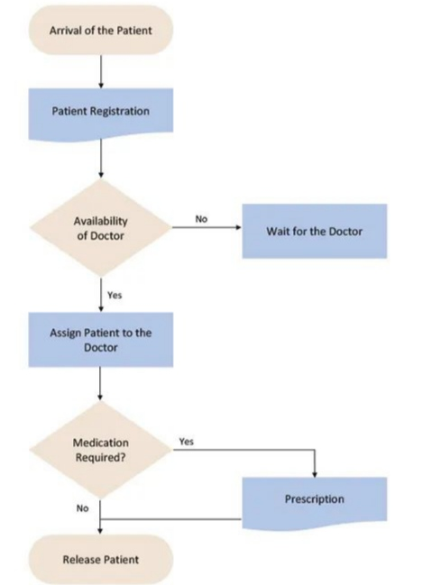
Flow chat

Slide 6
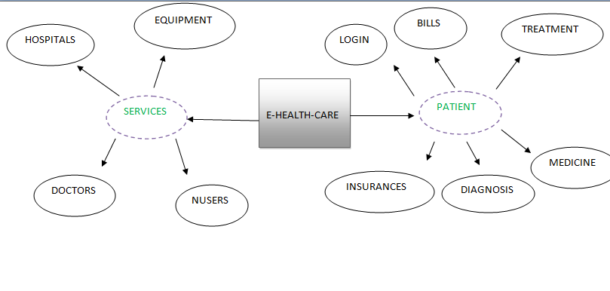

concept map

Slide 7




App Tools
Andriod studio
Appium inspector
Appium server
Lamdatest

Slide 8

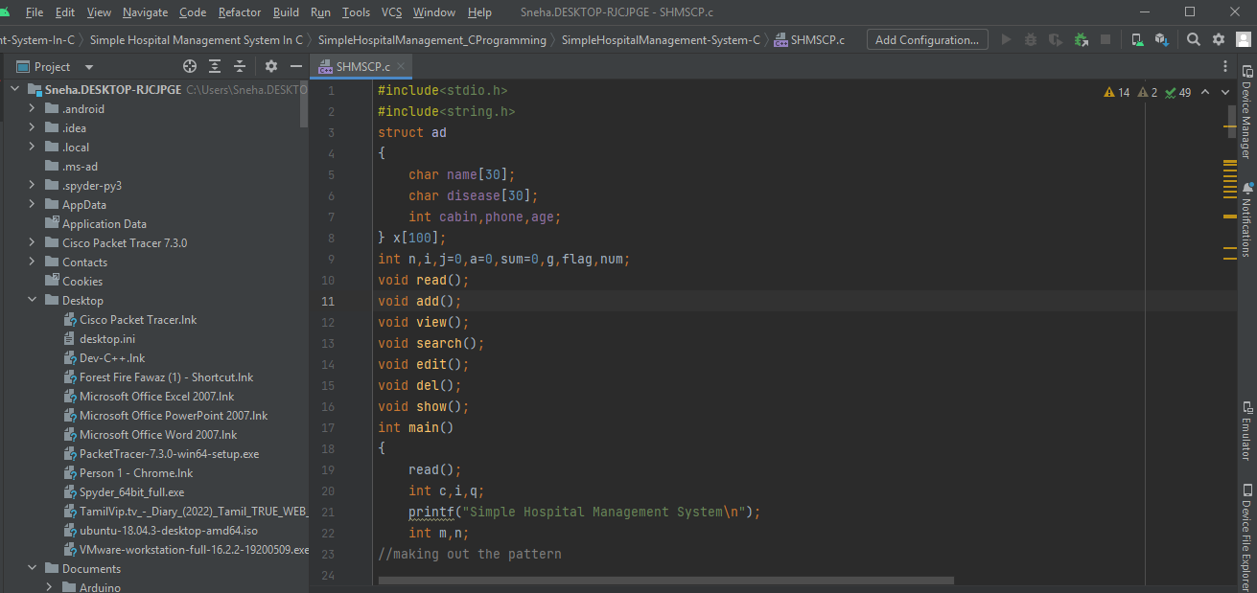
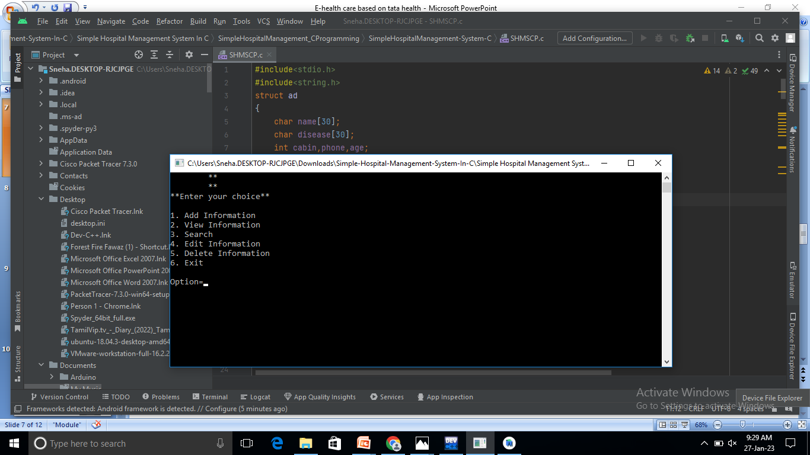
Implementation

Slide 9


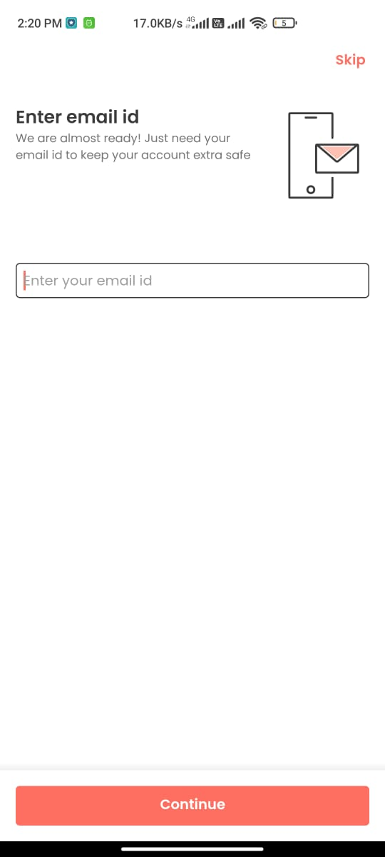
Detailed Instructions on how to buy on TATA 1mg products
1. Sign into your TATA 1mg account.
Go to www.tata 1mg.com in your web browser and log in. To
do this, move your mouse over “Get started, Sign In” and click SignIn.
Then click in the boxes highlighted in the right screenshot
below and type in your email address and account password,
respectively. Finally, click Sign In Using Our Secure Server.

Slide 10
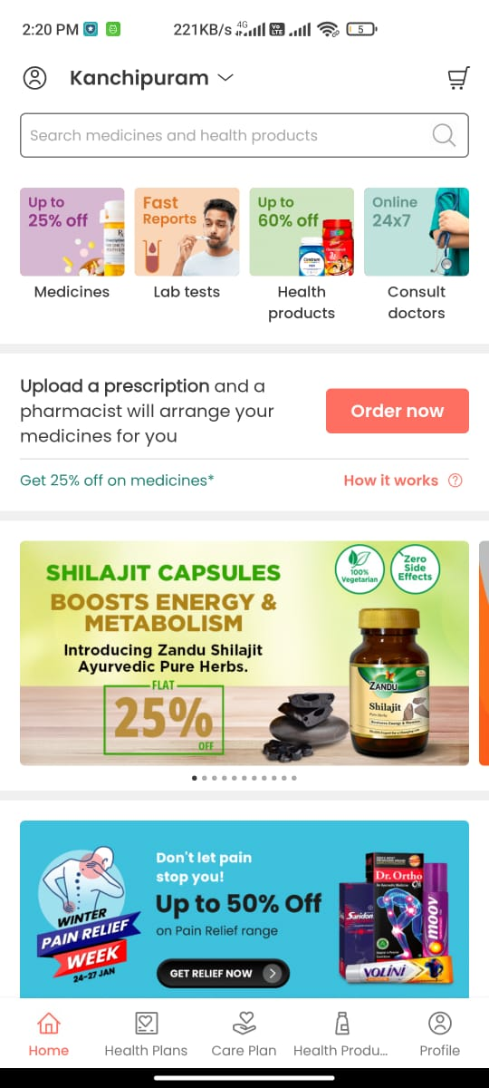
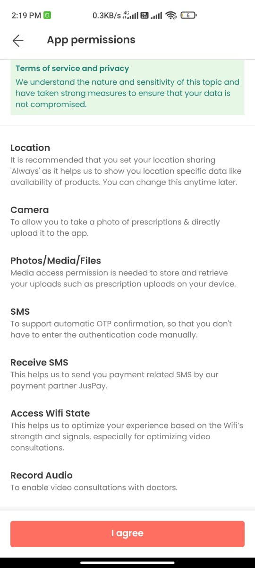
2.Search medicines and product
you’re looking for a new one. Let’s start by moving the mouse over up of search medicines and product

Slide 11
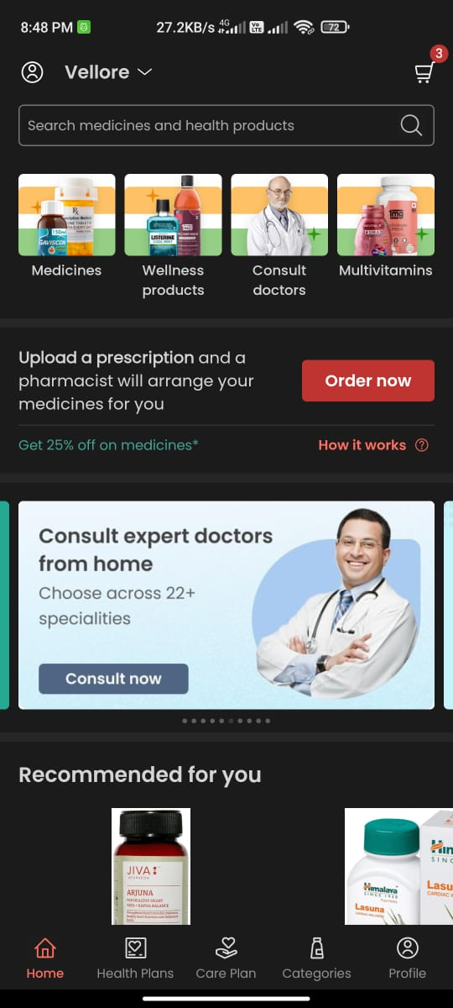
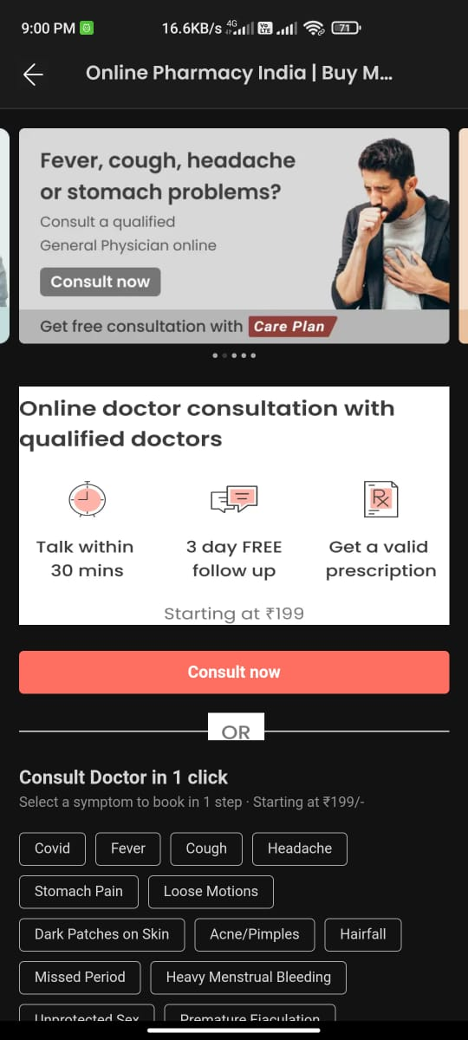
3. Online doctor consult
Online doctor consultation with qualified doctor

Slide 12
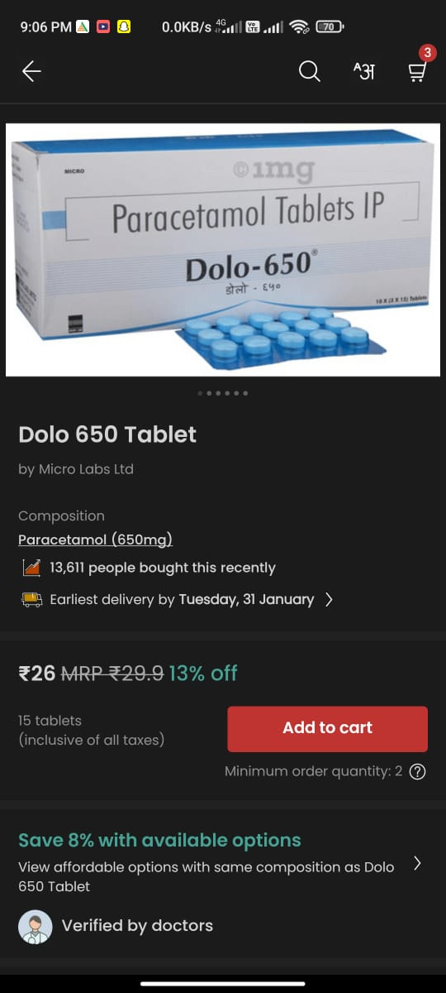
4. Find a specific category
Now, let’s there are top brand in Dolo click on Dolo 650 tablets just to narrow things down a bit more.

Slide 13
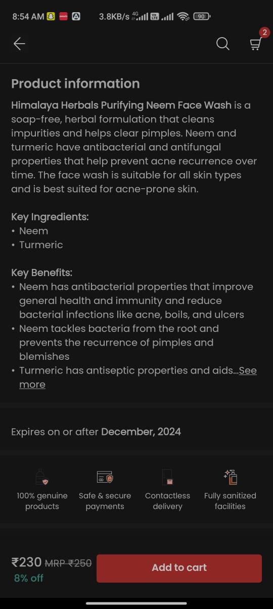
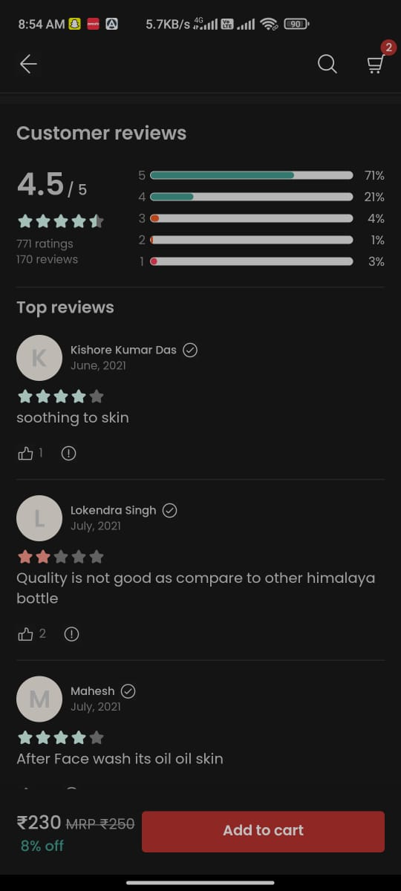
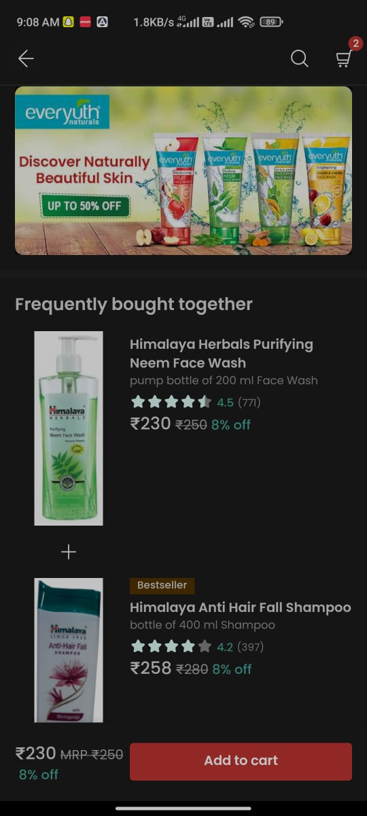
5. View and select an item.
You’ll now see a list of Tablets available for sale and product information

Slide 14
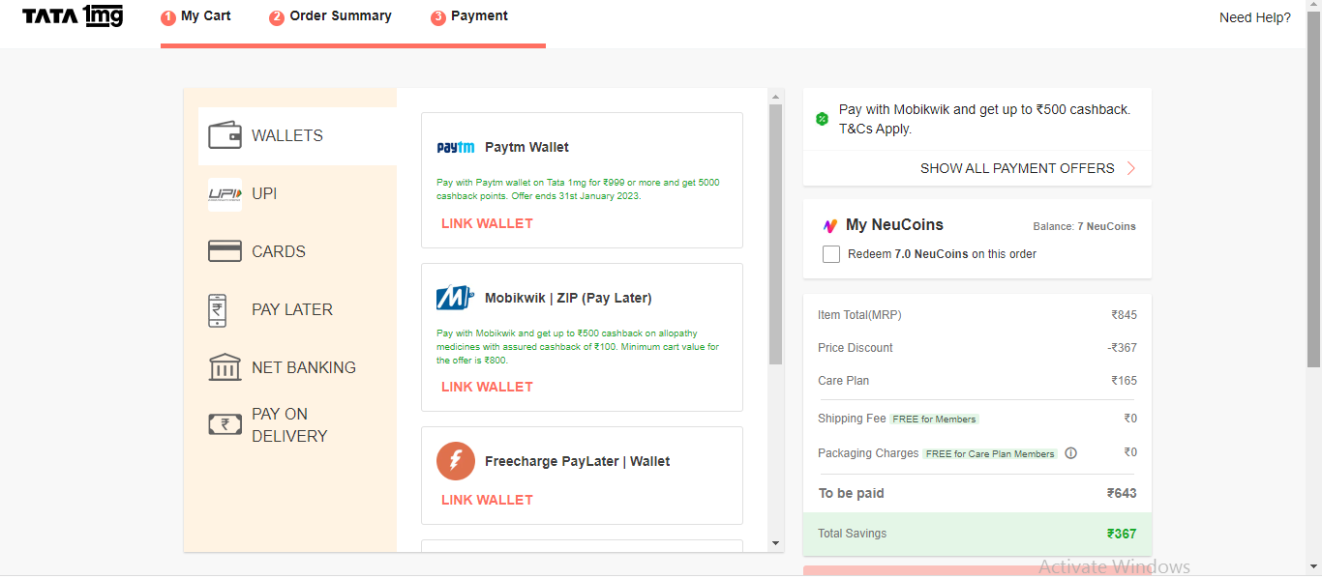
6. Choose a payment method.
You’ll now have to select a method of paying for your purchase.

Slide 15
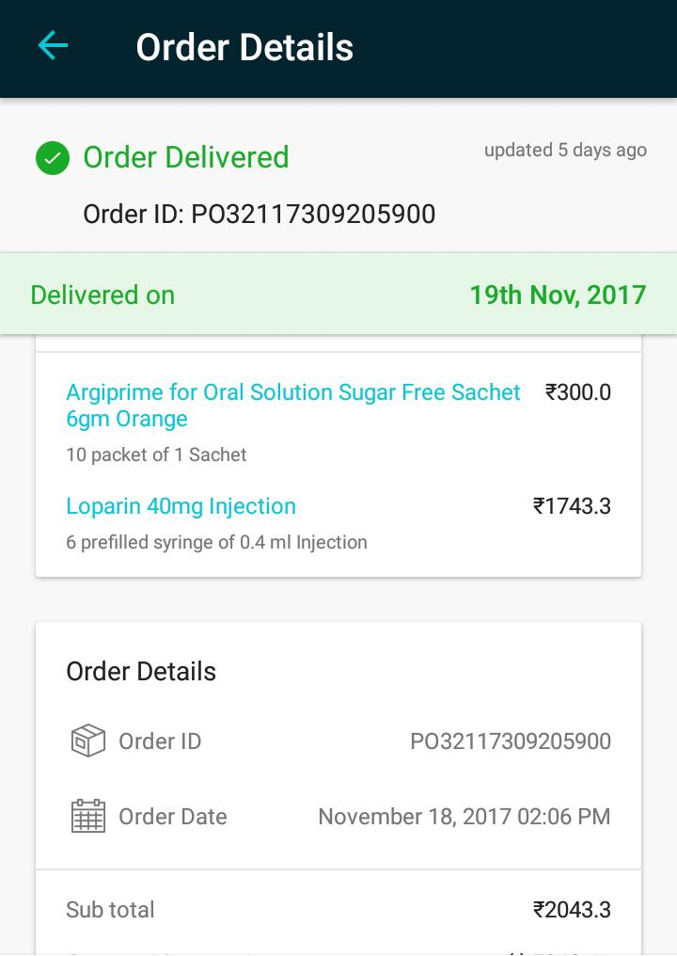
7. Confirm and place your order.
On the next screen, you can review your order and make any final changes, including the type of shipping you want. If you’re happy with what you have, click Place Your Order.

Slide 16
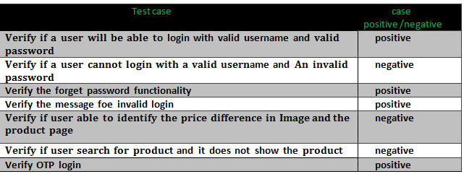
Test case

Slide 17
Conclusion
It can be said that TATA 1mg is the face of the current market global, digital, and constantly expanding. It is an increasingly productive brand, which adapts quickly to new demands, in a fast, effective and original way. For this reason, for now, even though it faces competition on all its fronts, individually, its corporate umbrella remains unparalleled and, therefore, must remain in the lead, for years to come.

